Slide 1

Laravel t07 Search
Tarmizi Sanusi
Khirulnizam Abd Rahman
fstm.kuis.edu.my/blog/laravel

Slide 2
Module Outcome
Day 2
Relationship
Show, Edit, Update & Delete
Using Named Route
Auth Middleware
Handling Error Page
Pagination

Slide 3
routes/web.php
app/Http/Controllers
app/
resources/views
Notes:
In Slide Show mode, select the arrows to visit links.

Slide 4
URL Named Route
The route helper may be used to generate URLs to named routes.
Named routes allow you to generate URLs without being coupled to the actual URL defined on the route.
Therefore, if the route's URL changes, no changes need to be made to your route function calls.
https://github.com/samtarmizi/laravel-spr/commit/fe5e375c4305294b817d8234fcdb21bbb0877fe4

Slide 5
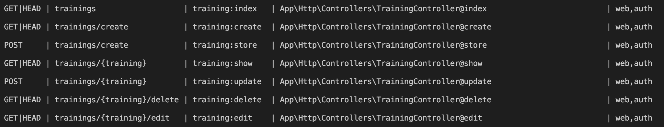
Routing
php artisan route:list
https://laravel.com/docs/6.x/routing.

Slide 6
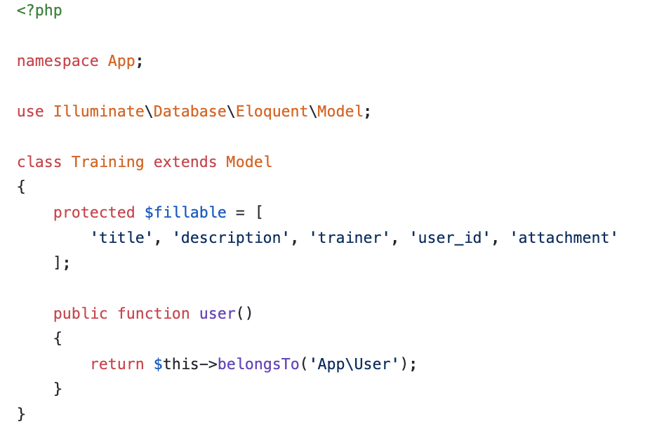
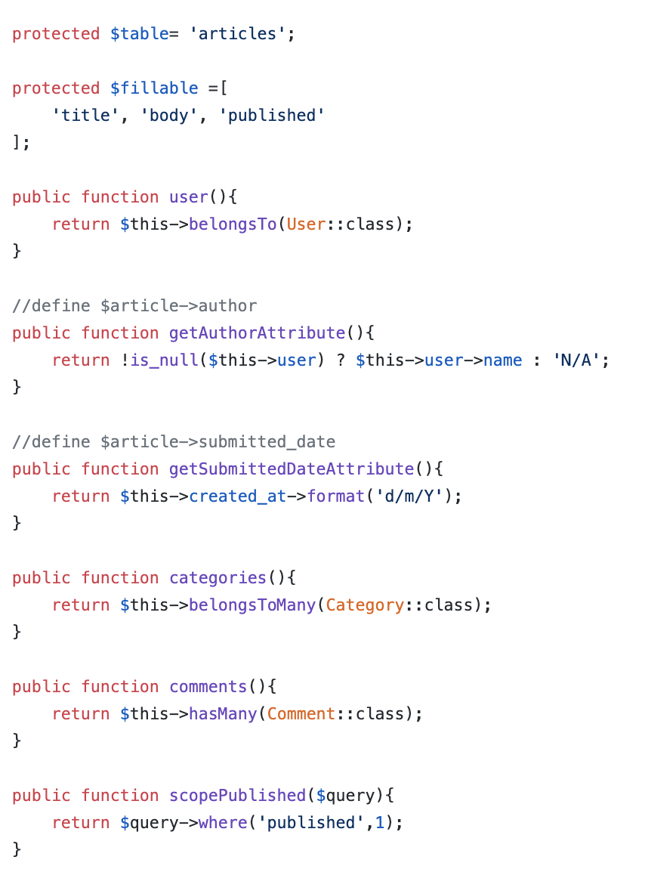
Model
Model used to define fillable attributes.
Model also can be used to define relationship
Model also can be used to to specify custom table.
Model also can be used to define mutator
Model also can be used to define local scope

Slide 7
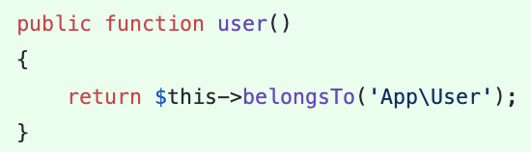
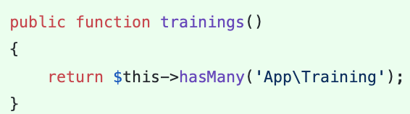
Relationship 1:M
A one-to-many relationship is used to define relationships where a single model owns any amount of other models.
User has many trainings
Training belongs to User
https://laravel.com/docs/6.x/eloquent-relationships#one-to-many
On Training.php
On User.php
https://github.com/samtarmizi/laravel-spr/commit/fa0e6673b4c73b13d2e8f2a33ef03ea22dfa50c4

Slide 8
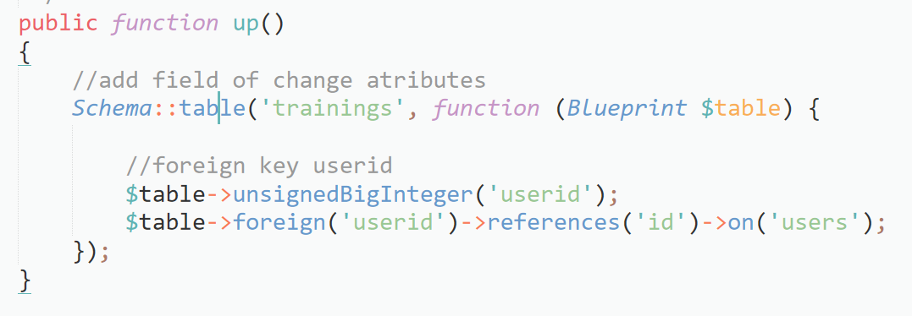
Alter table with relationship (alter_trainings_table)

Slide 9
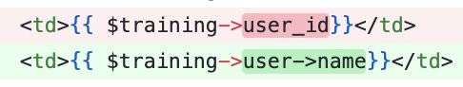
Relationship – Lazy Load Attribute
A one-to-many relationship is used to define relationships where a single model owns any amount of other models.

Slide 10
SHOW

Slide 11
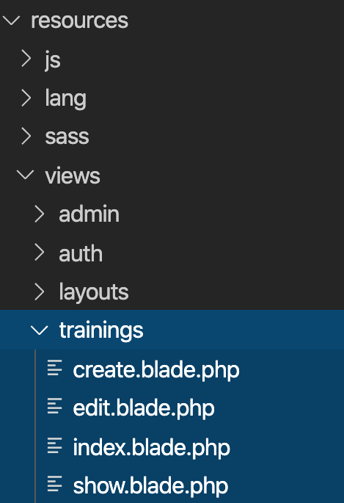
Views
Views are stored in the resources/views directory
Go to resources/views
Go to trainings folder, create:
show.blade.php
edit.blade.php

Slide 12
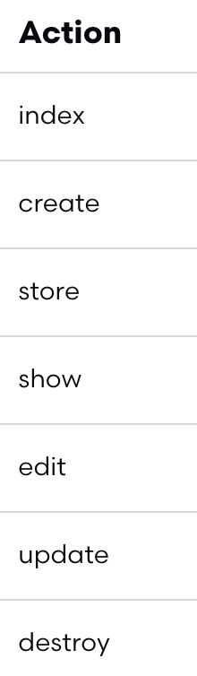
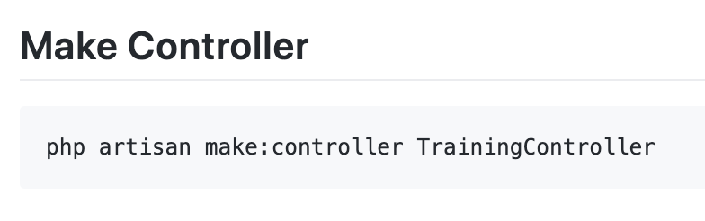
Controller
7 method in controllers

Slide 13
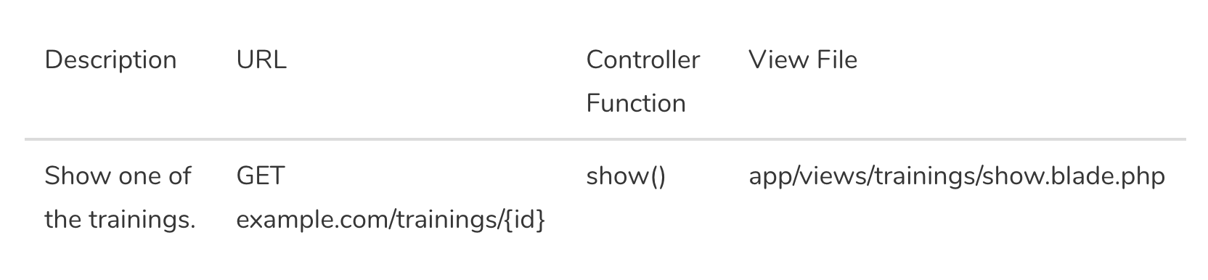
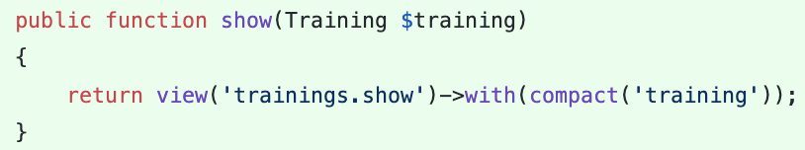
Controller - Show

Slide 14
Views – Show View
Views are stored in the resources/views directory
Go to resources/views/trainings/show.blade.php
https://github.com/samtarmizi/laravel-spr/blob/f024cb1035331aa1e845db71e5321ba154016140/resources/views/trainings/show.blade.php

Slide 15
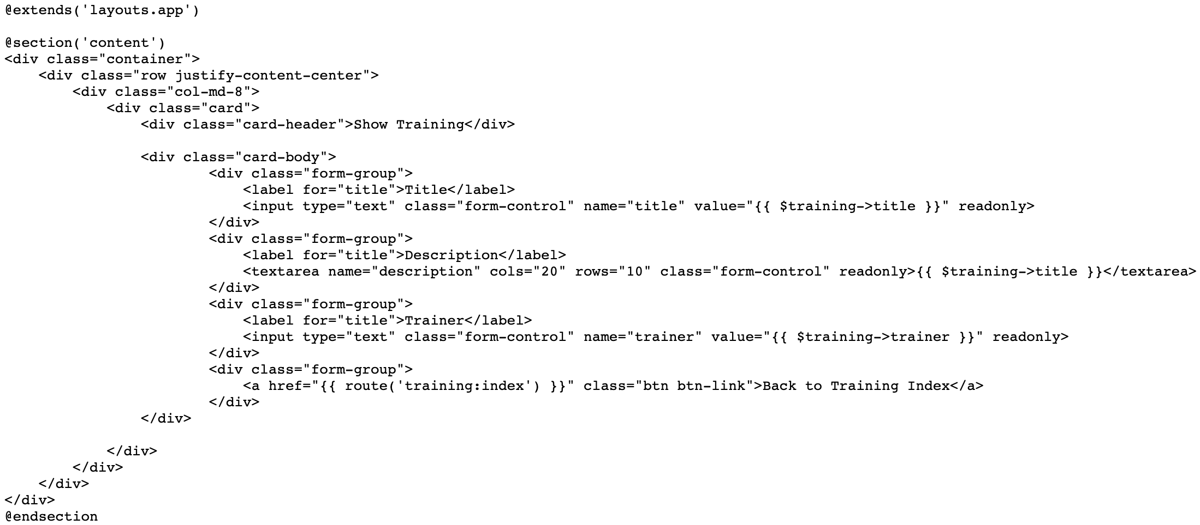

Slide 16
EDIT

Slide 17
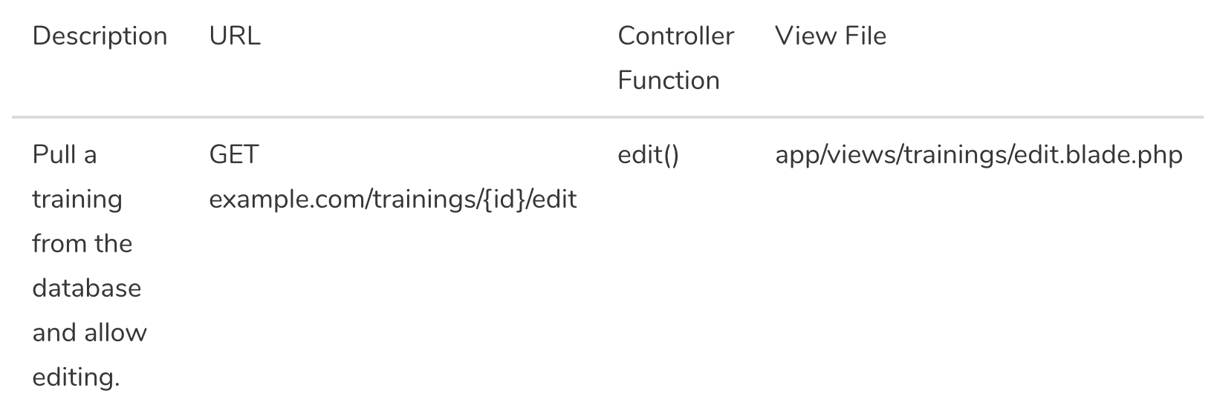
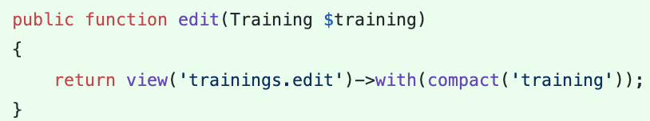
Controller - Edit

Slide 18
Views – Edit View
Views are stored in the resources/views directory
Go to
resources/views/trainings/edit.blade.php
https://github.com/samtarmizi/laravel-spr/blob/f024cb1035331aa1e845db71e5321ba154016140/resources/views/trainings/edit.blade.php

Slide 19
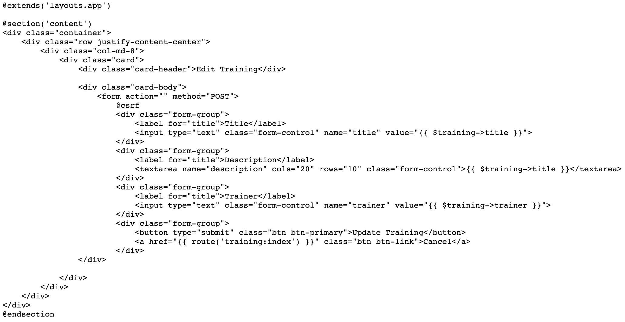

Slide 20
UPDATE

Slide 21
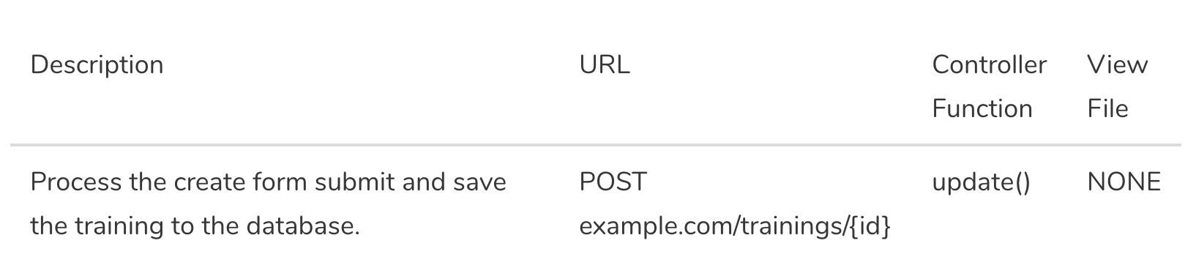
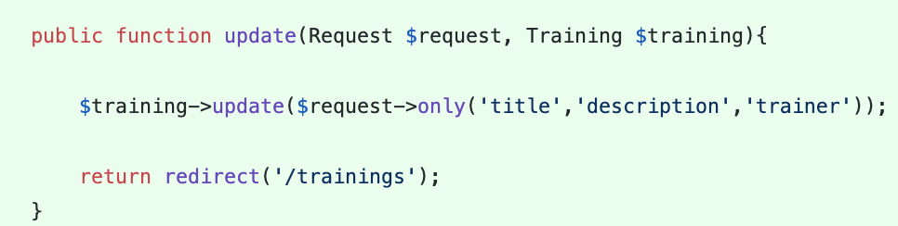
Controller - Update

Slide 22
DELETE

Slide 23
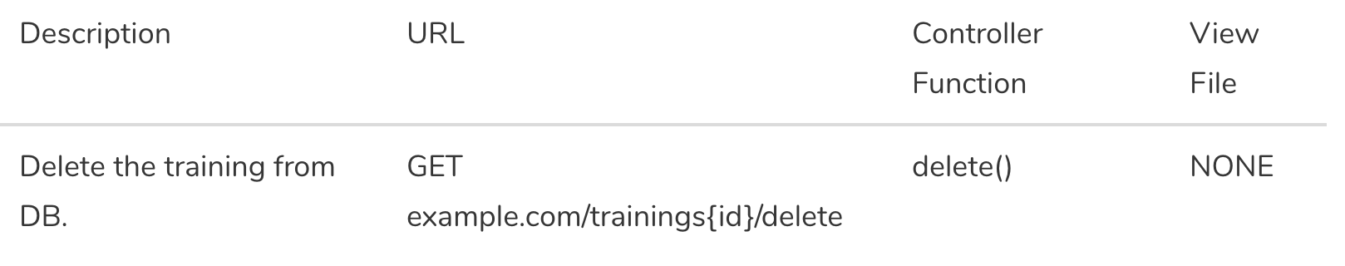
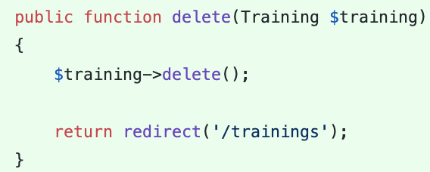
Controller – Destroy/Delete

Slide 24
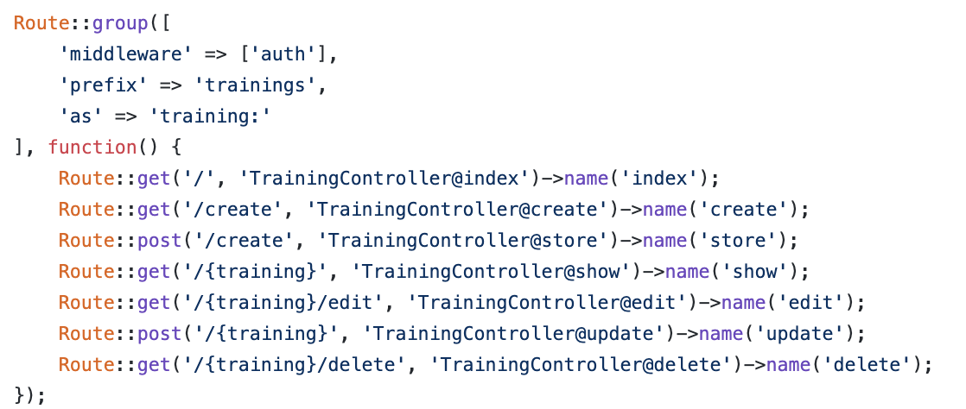
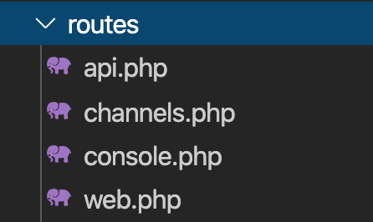
Routing – Group and Named Route
All Laravel routes are defined in your route files, which are located in the routes directory.
https://laravel.com/docs/6.x/routing.

Slide 25
Routing – Group and Named Route
php artisan route:list
https://laravel.com/docs/6.x/routing.

Slide 26
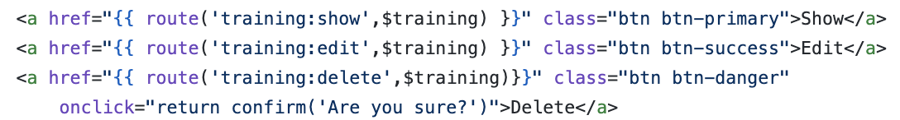
Routing – Named Route
Named route with model binding

Slide 27
Hacks
Creating Show - https://github.com/samtarmizi/laravel-spr/commit/3ab27f716f0647077a0d524739d1b62d6bbae6f0
Creating Edit - https://github.com/samtarmizi/laravel-spr/commit/f024cb1035331aa1e845db71e5321ba154016140
Creating Update - https://github.com/samtarmizi/laravel-spr/commit/08c8b57b3e4b1e79577c236b41f6c689c8c2679b
Creating Delete - https://github.com/samtarmizi/laravel-spr/commit/f886bdc85de7b1eb217e364909efae38f71223b2

Slide 28
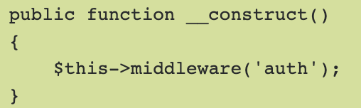
Middleware
Middleware provide a convenient mechanism for filtering HTTP requests entering your application.
For example, Laravel includes a middleware that verifies the user of your application is authenticated. If the user is not authenticated, the middleware will redirect the user to the login screen.

Slide 29
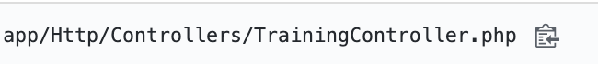
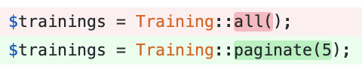
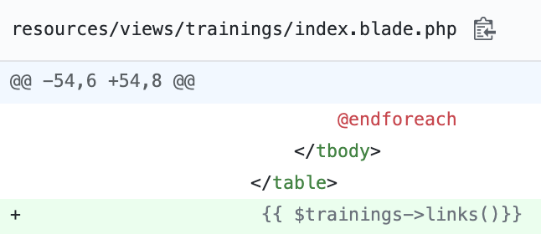
Pagination
The paginate method automatically takes care of setting the proper limit and offset based on the current page being viewed by the user.

Slide 30
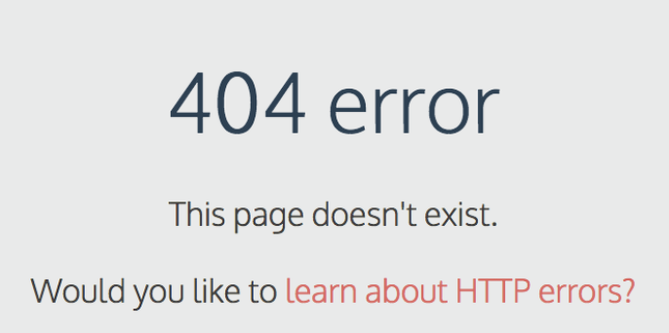
Laravel Error Page
Custom HTTP Error Pages
Create folder name errors in resources/views/
Example Http Error 404, create 404.blade.php

